Slide 1

GROUP 4
Raul Gutierrez
Aaron Caldwell
Michael Nguyen
Stephanie Delgado
Jonathan Escobedo

Slide 2
Dunder Mifflin Database
Dunder Mifflin Database systems is an organization in which office supplies are sold

Slide 3
Clients

Slide 4
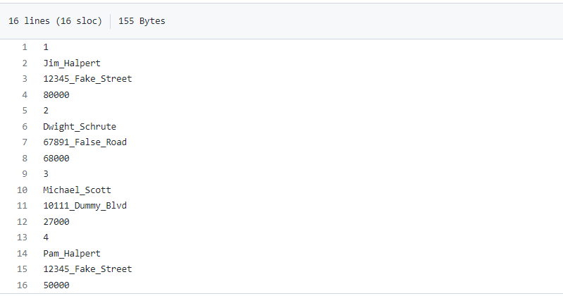
Sales Representatives
Here are the four Sales Representatives for Dunder Mifflin office supplies retailers.

Slide 5
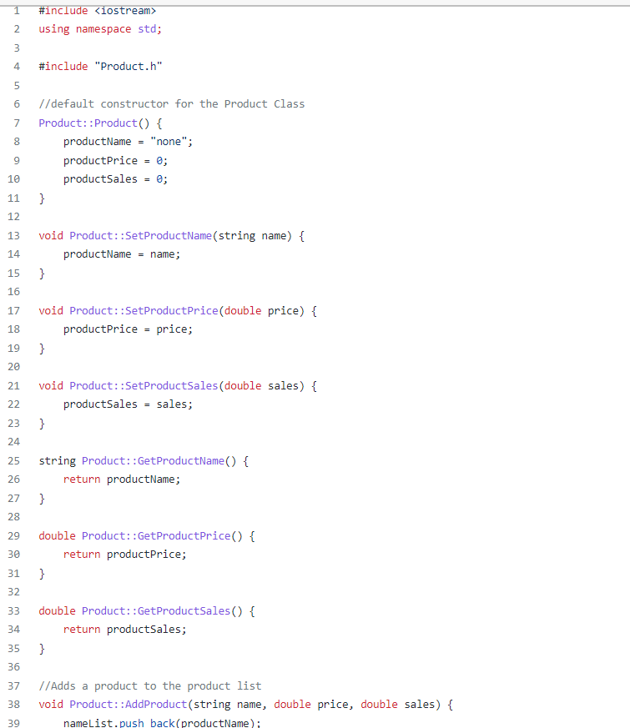
Products offered
Here is an example of the Products algorithm

Slide 6
Services

Slide 7
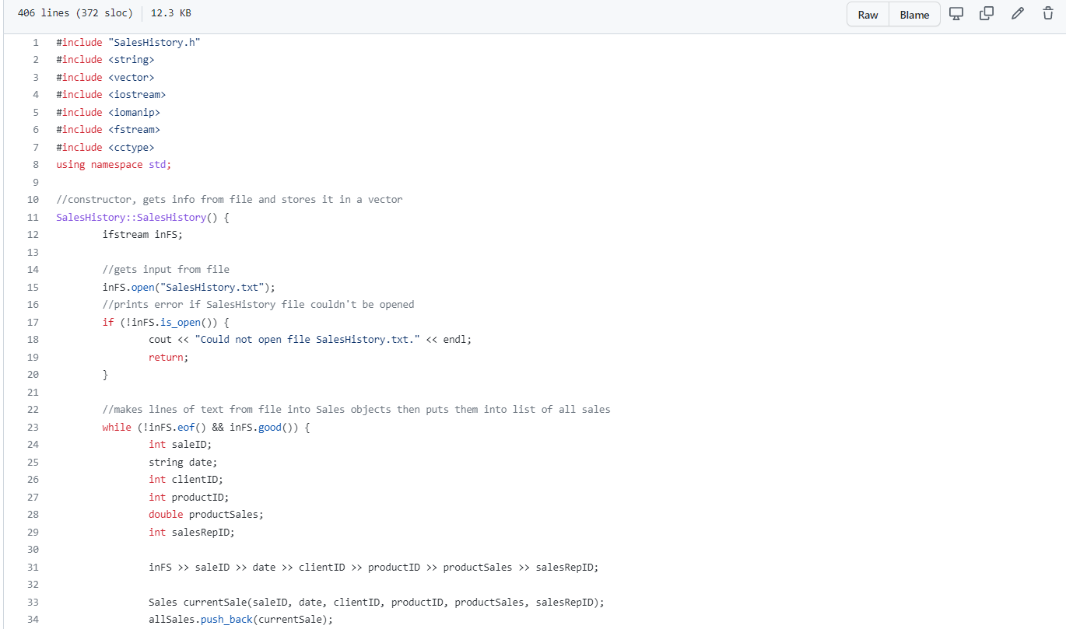
Sales
Here are the sales for Dunder Mifflin Database systems.

